Slide 1
University of Barishal 13th Batch
Presentation title: Projctor type monitor
SUBMITTED BY
Name:Rafia Aktar
Department of CSE-11th Batch
SUBMITTED TO
Prof.Md Mahbub E Noor
Course code-CSE1101
Course title-Introduction to computer system

Slide 2
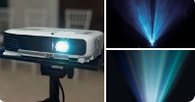
PROJECTOR TYPE MONITOR
A projector-type monitor typically
refers to a display system that
uses a projector to create an
image on a surface (like a wall or
screen), rather than using a
traditional flat-panel monitor .
In some contexts, projector type monitor also refer to devices that project interactive displays ,like interactive projectors or short-throw projectors that can be used for presentations , education or even home entertainment.

Slide 3
There are several types of projectors,including
LCD projectors:
These projectors are often used as a replacement for slide or overhead projectors. However ,they typically require filter maintenance and produce less contrast.
LED projectors:
These projectors are use light emitting diodes to display an image on the screen.they are often bright,high-fidelity and smaller in size.
DLP projectors:
These projectors use tiny mirrors to reflect light. They are the most commonly used projector technology for all types of applications.
Laser projectors:
These projectors use laser diodes as their light source and offer superior image quality,high contrast and exceptional color accuracy. They also have an impressive lifespan,often exceeding 20,000 hours.

Slide 4
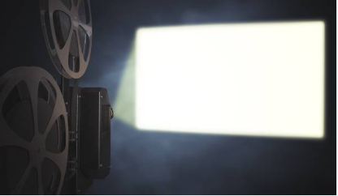
How does a projector works?
When you connect a projector to a
video source ,such as a computer
or a media player ,it receives the
video signal and processes it . The
projector then uses lamp or light
emitting diode(LED) light source to produce a bright beam of light. This light passes through a series of mirrors and lenses that help magnify and focus the image. The focused light is then projected onto a screen or wall, creating a larger image for the audience to see.

Slide 5
Advantage of projector over monitor
Screen size: Projectors can display much larger images than monitors.
Eye comfort : Projectors use indirect lighting which reduces eye strain.
Portability :Projectors are lightweight and easy to move around.
Cost: Projectors are often cheaper than TVs of similar size.
Disadvantage of projector over monitor
Brightness: Projectors are generally less bright than TVs, so ambient light can affect the image quality , especially during the day.
Image quality: When projecting a large image can be darker.
Room requirements: Projectors need a dark room to deliver their best image quality.
Eye safety: Looking directly at the projector lens while it’s on can damage your eyes.

Slide 6
Thank you

